Slide 1
Sigma Promoter Identication & Classication in E. coli bacteria from Genomic Data using Deep Learning
Presented by,
Rifat Rahman (0419052028)
Sonjoy Kumar Paul (0419052023)

Slide 2
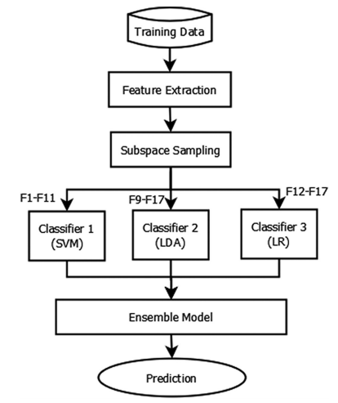
Related Works (iPromoter-FSEn)
Rahman et al. [1] developed iPromoter-FSEn for identifying bacterial σ70 promoter using feature subspace based ensemble classifier achieving an impressive accuracy of 86.32%.
Fig: System diagram of iPromoter-FSEn

Slide 3
Related Works (iPromoter-2L)
Liu et al. [2] implemented iPromoter-2L where they extracted physiochemical properties by
multi-window-based PseKNC. Authors used random forest classifier for classification.
Fig: A flow chart to show how the iPromoter-2L is working

Slide 4
Related Works (MULTiPly)
Zhang et al. [3] extracted both local (k-tuple nucleotide composition, dinucleotide based auto covariance) and global information (bi-profile Bayes and KNN feature encodings), and performed F-score feature selection method to identify the best unique type of feature prediction results. They used SVM classifier for classification.
Fig: The flowchart of the proposed multi-layer classifier

Slide 5
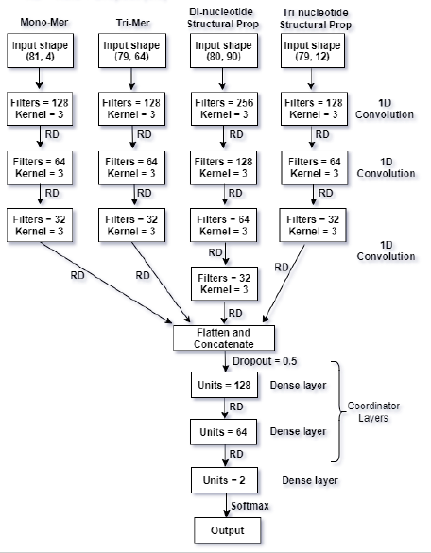
Related Works (iPromoter-BnCNN)
Amin et al. [4] combines local features related to mono-mer nucleotide sequence, tri-mer nucleotide sequence, di-mer structural properties and tri-mer structural properties through the use of parallel branching.
Fig: Parallel Branched CNN model Architecture

Slide 6
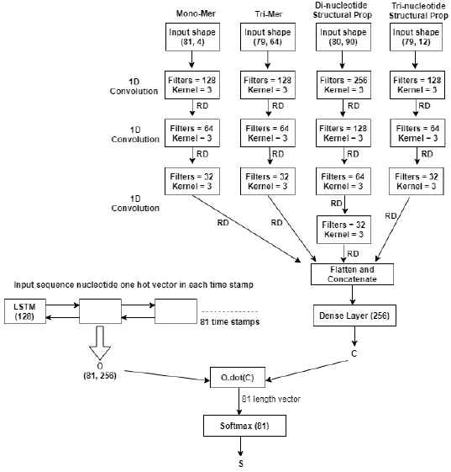
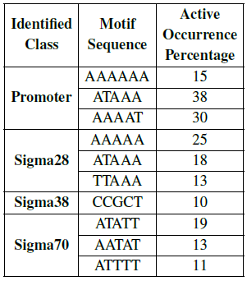
Related Works (iPromoter-BnCNN)
Potential Motif identification:
Fig: Attention mechanism for motif identification

Slide 7
Related Works
Silva et al. [5] integrated DNA duplex stability as feature of neural network to identify σ28 and σ54 class of promoter in E. coli bacteria.
Umarov and Solovyev [6] trained CNN based architecture to Recognize prokaryotic and eukaryotic promoters.

Slide 8
Gap Analysis
Most of the works implemented identifiers for one or two sigma factor dependent promoters except [2-4]
The sensitivity and specificity of promoter classification showed opposing behavior for iPromoter-2L [2]. For example, for σ28, σ32, σ38, and σ54, iPromoter-2L showed specificity of higher than 99%, but the sensitivity was lower than 54%.
The limitation of MULTiPly [3] was the selection of the basic features to work with. Different combination of different heterogeneous features led to different prediction results. Through trial and error, the authors selected features that achieved satisfactory prediction performance.
Implementation of multiple binary classifiers.

Slide 9
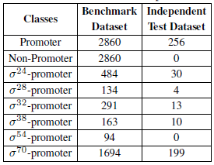
Proposed Method
Objective
Our goal is to implement a computational tool that will identify and classify promoters in E. coli bacteria automatically. We will also perform comparative study among different state-of-the-art works.
Benchmark Dataset Selection
Redundancy reduced “RegulonDB version-9.3”
Creating training and independent test dataset
DNA sequence length: 81 nucleotides
Table: Class-wise sample numbers in datasets used

Slide 10
Proposed Method
Mathematical Formulation of DNA Sequence
Original Nucleotide sequence
Mono-mer (81 x 4D)
Di-mer (80 x 16D)
Tri-mer (79 x 64D)
Structural Properties
Di-mer (80 x 90D)
Tri-mer (79 x 12D)
Here, rows are representing polymers from input sequence and columns are representing features.
Dimensionality Reduction and clustering (Our Novelty)
Auto-encoder/t-SNE/PCA
Clustering for purity checking

Slide 11
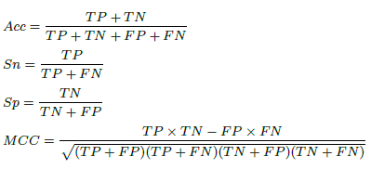
Proposed Method
Model Architecture (Our Novelty)
Sequence Model
Bi-LSTM based attention mechanism
Evaluation
Hyper-parameter Tuning
Number of hidden layers
Number of neurons
Function
Learning rate
Performance Metrics
Sensitivity
Specificity
Accuracy
MCC score

Slide 12
Proposed Method
Tools
Platform: Google colab
Language: Python
Library: keras with tensorflow background, scikit-learn, numpy, pandas, matplotlib etc
Public Access
We will keep source code & model files public.

Slide 13
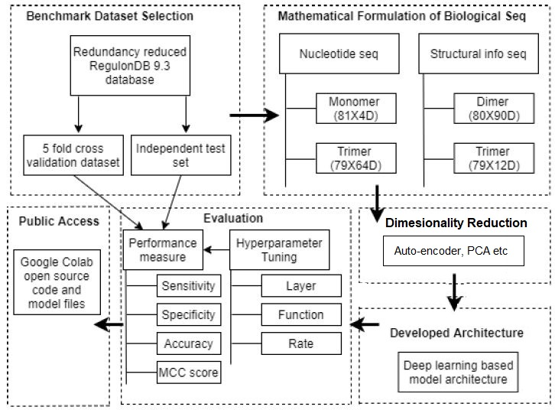
Proposed Method (Block Diagram)
Fig: Block diagram of our methodology

Slide 14
References
[1] Rahman, M. S. et al. (2019b). ipromoter-fsen: Identification of bacterial σ70 promoter sequences using feature subspace based ensemble classifier. Genomics, 111(5), 1160–1166.
[2] M B. Liu, F. Yang, D.-S. Huang, and K.-C. Chou, “ipromoter-2l: a two-layer predictor for identifying promoters and their types by multi-window-based pseknc,” Bioinformatics, vol. 34, no. 1, pp. 33-40, 2018.
[3] M. Zhang, F. Li, T. T. Marquez-Lago, A. Leier, C. Fan, C. K. Kwoh, K.-C. Chou, J. Song, and C. Jia, “Multiply: a novel multi-layer predictor for discovering general and specific types of promoters,” Bioinformatics, vol. 35, no. 17, pp. 2957-2965, 2019.
[4] R. Amin, C. R. Rahman, S. Ahmed, M. Sifat, H. Rahman, M. N. K. Liton, M. Rahman, M. Khan, Z. Hossain, S. Shatabda et al., “ipromoter-bncnn: a novel branched cnn based predictor for identifying and classifying sigma promoters,” Bioinformatics, 2019.
[5] S. d. A. e Silva, F. Forte, I. T. Sartor, T. Andrighetti, G. J. Gerhardt, A. P. L. Delamare, and S. Echeverrigaray, “DNA duplex stability as discriminative characteristic for escherichia coli σ54-and σ28-dependent promoter sequences," Biologicals, vol. 42, no. 1, pp. 22{28, 2014.
[6] R. K. Umarov and V. V. Solovyev, “Recognition of prokaryotic and eukaryotic promoters using convolutional deep learning neural networks,” PloS one, vol. 12, no. 2, p. e0171410, 2017.

Slide 15
Thank You

